Slide 1

PROJECT NAME – “ MICRO CREDIT DEFAULTER PROJECT ”
SUBMITTED BY – AMAN KUMAR PATEL
BATCH – INTERNSHIP 25

Slide 2
AGENDA
Overview.
Problem Statement.
What is Micro Credit And it’s importance?
Exploratory data analysis.
Visualizations.
Analysis.
Data cleaning steps.
Model Building.
Hyper Parameter Tunning.
ROC Curve For Final Model.
Saving the model and predictions from saved best model.
Conclusion.

Slide 3
Overview:
In this presentation we will be getting on:
How to analyze the dataset of Micro Credit Defaulters.
What are the EDA and the special steps in cleaning the dataset.
Overall analysis on the problem.
After that Model building from the cleaned dataset.
Predicting defaulters for saved model which is done after all the steps.

Slide 4
Problem Statement:
A Microfinance Institution (MFI) is an organization that offers financial services to low income populations. MFS becomes very useful when targeting especially the unbanked poor families living in remote areas with not much sources of income. The Microfinance services (MFS) provided by MFI are Group Loans, Agricultural Loans, Individual Business Loans and so on. Many microfinance institutions (MFI), experts and donors are supporting the idea of using mobile financial services (MFS) which they feel are more convenient and efficient, and cost saving, than the traditional high-touch model used since long for the purpose of delivering microfinance services. Though, the MFI industry is primarily focusing on low income families and are very useful in such areas, the implementation of MFS has been uneven with both significant challenges and successes. Today, microfinance is widely accepted as a poverty-reduction tool, representing $70 billion in outstanding loans and a global outreach of 200 million clients. We are working with one such client that is in Telecom Industry. They are a fixed wireless telecommunications network provider. They have launched various products and have developed its business and organization based on the budget operator model, offering better products at Lower Prices to all value conscious customers through a strategy of disruptive innovation that focuses on the subscriber.

Slide 5

What is Micro Credit and it,s importance ?
Microcredit is smallest loan given to those who lack a steady source of income like so many families , collateral. It is used as a way to get a loan, acting as a protection against potential loss for the lender should the borrower default in his payments., or any credit history.
The very important point is that Poverty alleviation programs provide material, funds, information and project services for people with no income or work opportunities. Because of the credit risks and relatively high costs associated with small loans, the traditional banking system is generally not willing to implement a microcredit system

Slide 6
Exploratory Data Analysis:
As we know firstly important libraries is important ,I have imported required necessary libraries and I have imported the dataset which was in csv format.
Then I checked all the statistical analysis like columns , shape, nunique, value counts, info, zeroes and many more.
I checked the null values I found there is no null values in the dataset.
Then I have extracted day, month, year from pdate in features extracting and drop pdate column.
While checking the value counts of the datasets I found so much columns with more than 90% zero values, so these columns will create skewness in datasets so I decided to drop those columns.
I got , In the dataset there were some –ve values so I converted those negative values to positive values using abs otherwise that will clearly affect on my models.

Slide 7
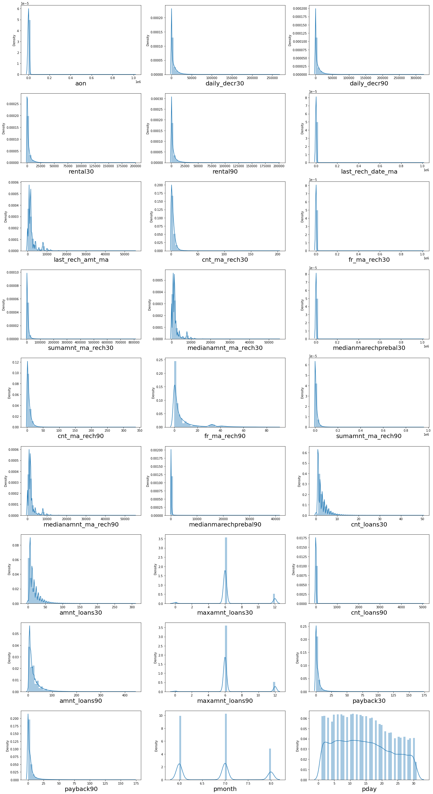
VISUALISATION (UNIVARIATE ANALYSIS)

Slide 8
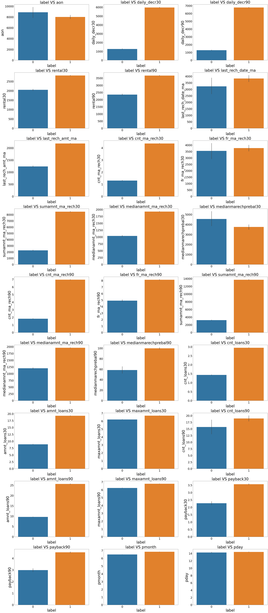
VISUALISATION (BIVARIATE ANALYSIS)

Slide 9
OBSERAVTION:
high value of Age on cellular network in days(aon) are maximum defaulters(who have not paid there loan amount-0).
high value of Daily amount spent from main account, averaged over last 30 days (in Indonesian Rupiah)(daily_decr30) are maximum Non-defaulters(who have paid there loan amount-1).
high value of Daily amount spent from main account, averaged over last 90 days (in Indonesian Rupiah)(daily_decr90) are maximum Non-defaulters(who have paid there loan amount-1).
high value of Average main account balance over last 30 days(rental30) are maximum Non-defaulters(who have paid there loan amount-1).
high value of Average main account balance over last 90 days(rental90) are maximum Non-defaulters(who have paid there loan amount-1).
high Number of days till last recharge of main account(last_rech_date_ma) are maximum Non-defaulters(who have paid there loan amount-1).
high value of Amount of last recharge of main account (in Indonesian Rupiah)(last_rech_amt_ma) are maximum Non-defaulters(who have paid there loan amount-1).
high value of Number of times main account got recharged in last 30 days(cnt_ma_rech30) are maximum Non-defaulters(who have paid there loan amount-1).
high value of Frequency of main account recharged in last 30 days(fr_ma_rech30) are maximum Non- defaulters(who have paid there loan amount-1) and also the count is high for defaulters comparitively Non-defaulters are more in number.
high value of Total amount of recharge in main account over last 30 days (in Indonesian Rupiah)(sumamnt_ma_rech30) are maximum Non-defaulters(who have paid there loan amount-1).

Slide 10
high value of Number of times main account got recharged in last 30 days(cnt_ma_rech30) are maximum Non-defaulters(who have paid there loan amount-1).
high value of Frequency of main account recharged in last 30 days(fr_ma_rech30) are maximum Non-defaulters(who have paid there loan amount-1) and also the count is high for defaulters comparitively Non-defaulters are more in number.
high value of Total amount of recharge in main account over last 30 days (in Indonesian Rupiah)(sumamnt_ma_rech30) are maximum Non-defaulters(who have paid there loan amount-1).
high value of Median of amount of recharges done in main account over last 30 days at user level (in Indonesian
Rupiah)(medianamnt_ma_rech30) are maximum Non-defaulters(who have paid there loan amount-1).
high value of Median of main account balance just before recharge in last 30 days at user level (in Indonesian Rupiah)(medianmarechprebal30) are maximum defaulters(who have not paid there loan amount-0).
high value of Number of times main account got recharged in last 90 days(cnt_ma_rech90) are maximum Non-defaulters(who have paid there loan amount-1).
high value of Frequency of main account recharged in last 90 days(fr_ma_rech90) are maximum Non-defaulters(who have paid there loan amount-1).
high value of Total amount of recharge in main account over last 90 days (in Indonasian Rupiah)(sumamnt_ma_rech90) are maximum Non-defaulters(who have paid there loan amount-1).
high value of Median of amount of recharges done in main account over last 90 days at user level (in Indonasian
Rupiah)(medianamnt_ma_rech90) are maximum Non-defaulters(who have paid there loan amount-1).
high value of Median of main account balance just before recharge in last 90 days at user level (in Indonasian Rupiah)(medianmarechprebal90) are maximum Non-defaulters(who have paid there loan amount-1).
high value of Number of loans taken by user in last 30 days(cnt_loans30) are maximum Non-defaulters(who have paid there loan amount-1).
high value of Total amount of loans taken by user in last 30 days(amnt_loans30) are maximum Non-defaulters(who have paid there loan amount-1).
high value of maximum amount of loan taken by the user in last 30 days(maxamnt_loans30) are maximum Non-defaulters(who have paid there loan amount-1).
high value of Number of loans taken by user in last 90 days(cnt_loans90) are maximum Non-defaulters(who have paid there loan amount-1).
high value of Total amount of loans taken by user in last 90 days(amnt_loans90) are maximum Non-defaulters(who have paid there loan amount-1).
high value of maximum amount of loan taken by the user in last 90 days(maxamnt_loans90) are maximum Non-defaulters(who have paid there loan amount-1).
high value of Average payback time in days over last 30 days(payback30) are maximum Non-defaulters(who have paid there loan amount-1).

Slide 11
Analysis:
Firstly I have seprate all categorical columns and and numerical and I did not any columns In categorical columns.
I have used dist plot for each univariate numerical features and it says that there is skewness in almost all columns.
And also for bivariate numerical features I have used bar plot.
I found that in maximum features the count of non-defaulters is high compared to defaulters so the risk is less comparitively.

Slide 12
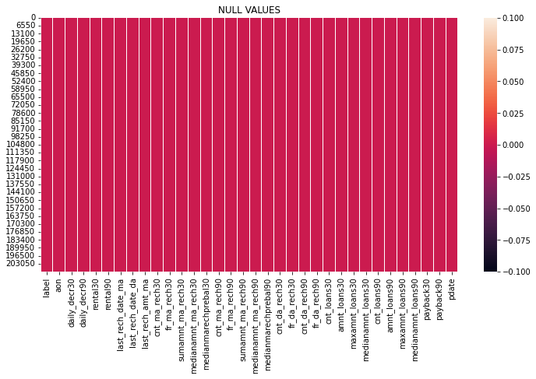
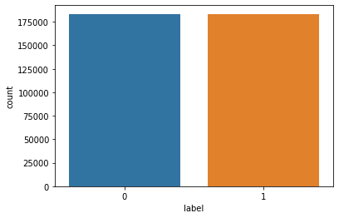
Data Cleaning Steps:
Since I was checking all skewness and outliers In my datasets I did not found null values, but I found outliers and also skewness.
I have removed outliers I have used percentile method. And to remove skewness I have used yeo-johnson method.
To replace the negative values from positive values I have used abs.
Use of Pearson’s correlation coefficient to check the correlation between dependent and independent features.
Also I have used Normalization. Then followed by model building with all Classification algorithms.
And when I checked about the balancing the data then I found my data is not balanced then I balanced using SMOTE .

Slide 13
Model Building:
Here we can see Label was my target columns which is having only two value and it was a Categorical column, so this perticular problem was binary Classification problem. And I have used all Classification algorithms to build my model. And by looking into the difference of accuracy score and cross validation score I found BaggingClassifier as a best model with least difference. Also to get the best model we have to run through multiple models and to avoid the confusion of overfitting we have go through cross validation. Below are the list of Classification algorithms I have used in my project.
XGBClassifier
K- neighbour classifier
Gradient Boosting Classifier
DecisionTreeClassifier
ADA – Booster classifier
BaggingClassifier
AdaBoostClassifier

Slide 14
XGBClassifier has given me 89.34 %accuracy and the difference between model accuracy and cross validation score is 0.23, but still we have to look into multiple models.
K- neighbour classifier has given me 89.61% accuracy , but still we have to look into multiple models.
Gradient Boosting classifier has given me 90.61% accuracy , but still we have to look into multiple models.
Decision Tree classifier has given me 91.14% accuracy , but still we have to look into multiple models and cross validation score is 0.29
ADA – Booster classifier has given me 85.06% accuracy and the difference between model accuracy and cross validation score is 0.11, but still we have to look into multiple models.
Bagging Classifier has given me 93.88% accuracy and the difference between model accuracy and cross validation score is 0.56, but still we have to look into multiple models.

Slide 15
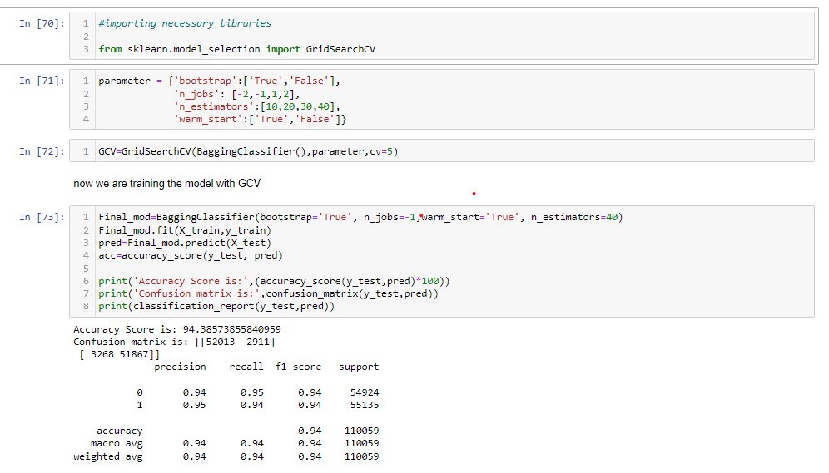
Hyper Parameter Tunning.
I have choosed all parameters of Bagging Classifier, after tunning the model with best parameters I have increased my model accuracy from 93.88% to 94.38%.

Slide 16
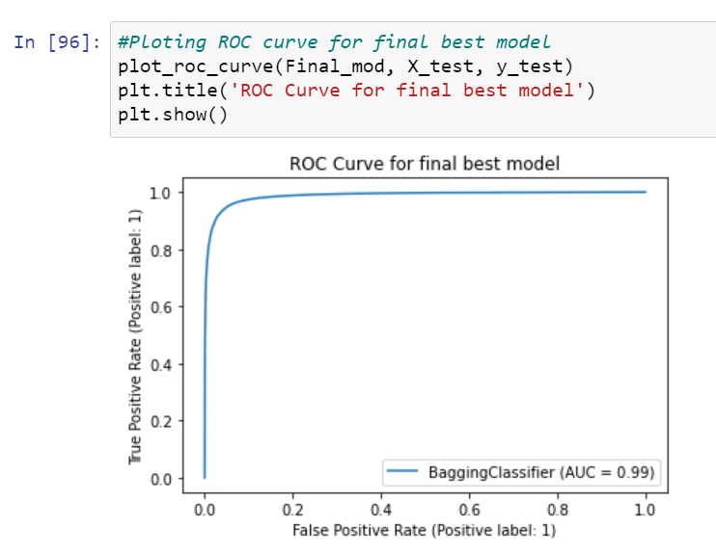
ROC Curve For Final Model
It is best, after applying hyper parameter tuning I have improved in roc curve and AUC also.

Slide 17
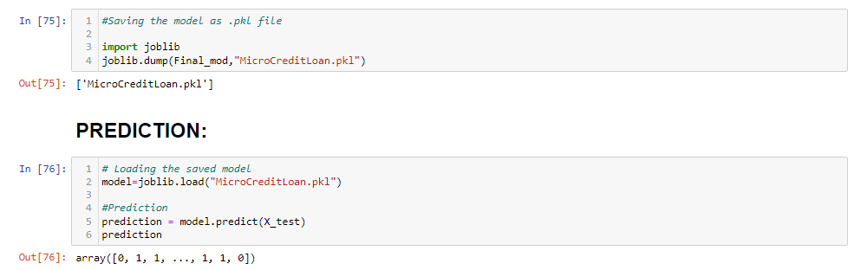
Saving the model and predictions from saved best model.
I have saved my best model using .pkl as the instruction
Now after saving the best model, loading my saved model and predicting.
I have predicted the defaulters using saved model, and the predictions look good. And the predictions are almost similar to actual values.

Slide 18
Conclusion:
In this particular project defaulter model , I have used machine learning algorithms to predict the micro credit defaulters. We have mentioned the step by step procedure to analyze the dataset and finding the correlation between the features.
Thus we can select the features which are correlated to each other and are independent in nature. The power of visualization has helped us in understanding the data by graphical representation it has made me to understand what data is trying to say.
Data cleaning is one of the most important steps to remove unrealistic values and zero values.
These feature set were then given as an input to four algorithms and a hyper parameter tunning was done to the best model and the accuracy has been improved. Hence we calculated the performance of each model using different performance metrics and compared them based on these metrics.
Then we have also saved the best model and predicted the label. It was good the the predicted and actual values were almost same.
To conclude, the application of machine learning in micro credit is still at an early stage. We hope this study has moved a small step ahead in providing some methodological and empirical contributions to crediting institutes, and presenting an alternative approach to the valuation of defaulters.
Future direction of research may consider incorporating additional micro credit transaction data from a larger economical background with more features.

Slide 19

THANK
YOU

